Slide 1
College Admission Agent (RAG-Based)
CAPSTONE PROJECT
Presented By:
P Chandra Hasini-KL UNIVERSITY-AI&DS

Slide 2
OUTLINE
Problem Statement (Should not include solution)
Proposed System/Solution
System Development Approach (Technology Used)
Algorithm & Deployment
Result (Output Image)
Conclusion
Future Scope
References

Slide 3
Problem Statement
The college admission process often overwhelms students with complex information about eligibility, deadlines, and courses. Institutions handle countless inquiries manually, leading to inefficiencies and delays. There’s a strong need for an intelligent system that can simplify and streamline the process using real-time and trusted information sources.

Slide 4
Proposed Solution
The proposed system aims to address the challenge of simplifying and streamlining the college admission process using a Retrieval-Augmented Generation (RAG) based AI agent. The solution will consist of the following components:
Data Collection:
Gather institutional data including:
Course offerings, eligibility criteria, and fee structures
Data Preprocessing:
Clean and organize unstructured admission-related documents (PDFs, DOCs, etc.).
Perform text normalization, keyword tagging, and metadata extraction.
RAG-Based AI Agent:
Implement a Retrieval-Augmented Generation pipeline combining:
Retriever: to fetch relevant data chunks from institutional content
Deployment:
Develop a user-friendly chatbot/web-based interface for real-time student interaction
Use IBM Cloud Lite for deployment with a scalable backend
Enable multilingual support and responsive design for mobile/desktop platforms
Evaluation:
Measure system performance using: Accuracy of responses and Response latency and user satisfaction feedback.
Result:
A functional AI-based admission assistant that answers queries with high accuracy

Slide 5
System Approach
IBM Granite (LLM)
The "System Approach" section outlines the overall strategy and methodology for developing and implementing the rental bike prediction system. Here's a suggested structure for this section:
IBM Cloud Lite Services
IBM Granite (LLM)
Python (Flask) for UI
MongoDB/Cloudant for data
APIs for data retrieval and live updates

Slide 6
Algorithm & Deployment
In the Algorithm section, describe the machine learning algorithm chosen for predicting bike counts. Here's an example structure for this section:
Algorithm Selection:
Implement a RAG architecture combining: Dense retriever for querying institutional FAQs/documents.
Training Process:
A curated dataset of institutional FAQs, admission documents, past queries, and official notifications.
Prediction Process:
The retriever searches the knowledge base for the top-k most relevant chunks.

Slide 7
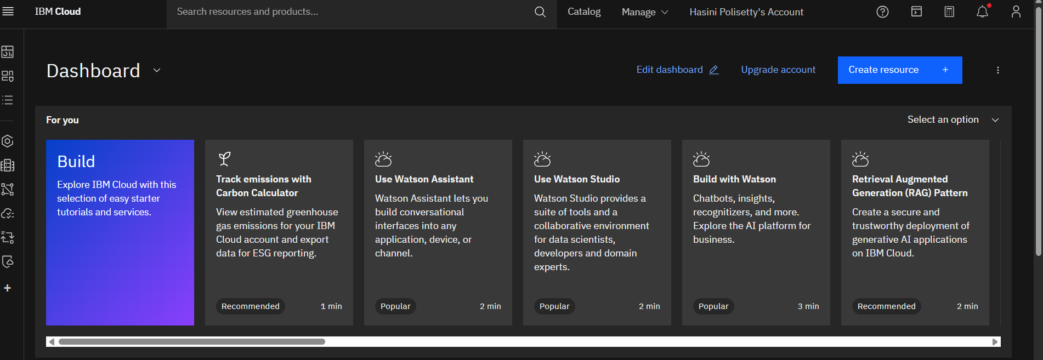
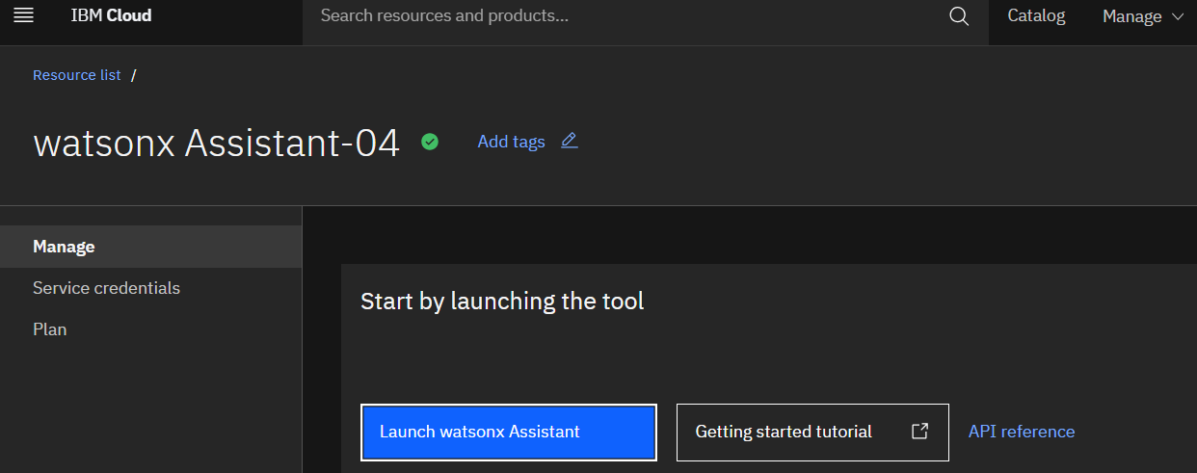
Algorithm & Deployment

Slide 8
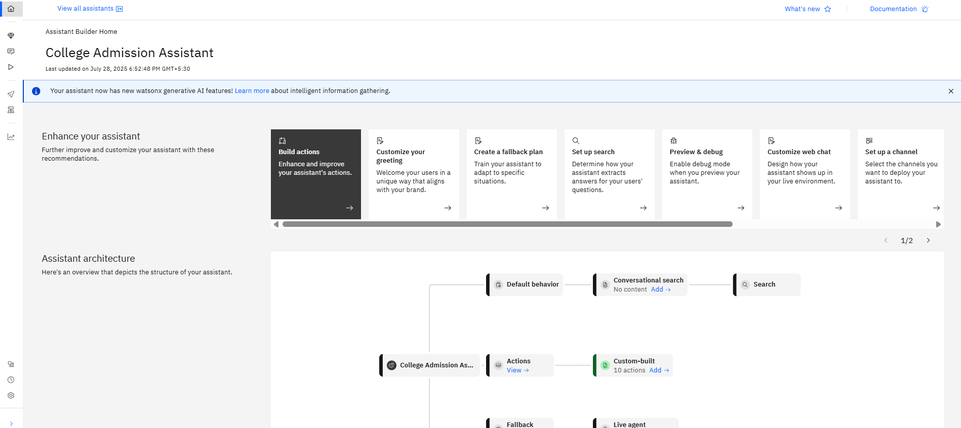
Algorithm & Deployment

Slide 9
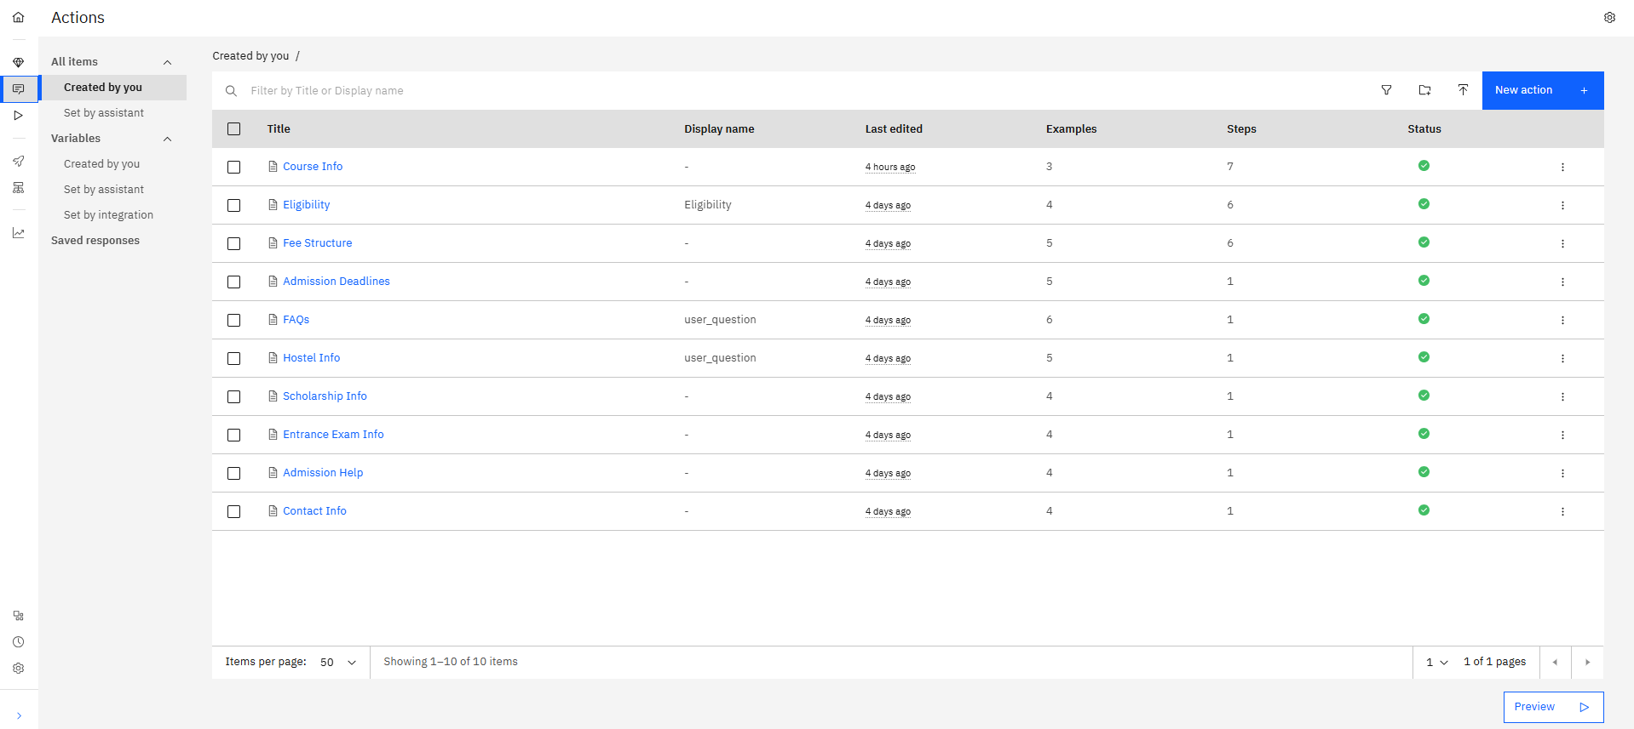
Algorithm & Deployment

Slide 10
Result
A functional AI-based admission assistant that answers queries with high accuracy
Real-time information access for students, reducing manual workload for staff
Enhanced admission transparency, applicant engagement, and accessibility

Slide 11
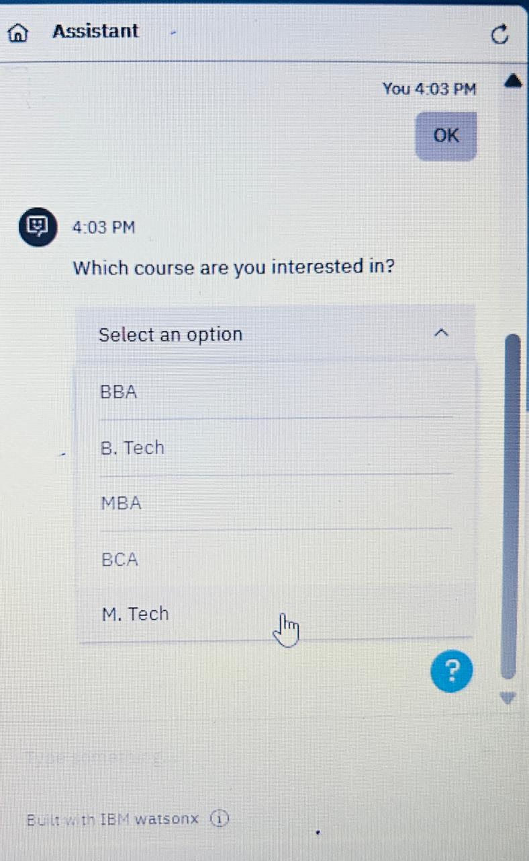
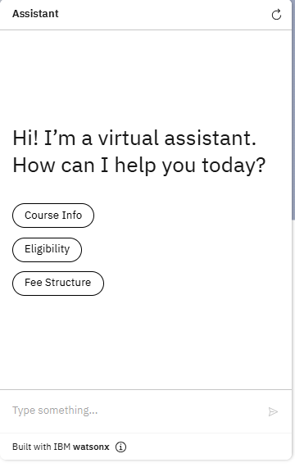
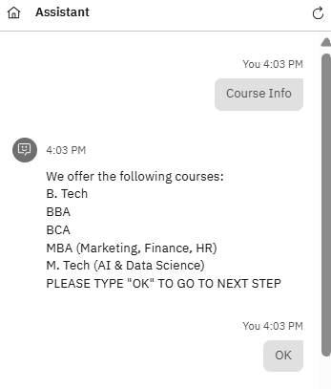
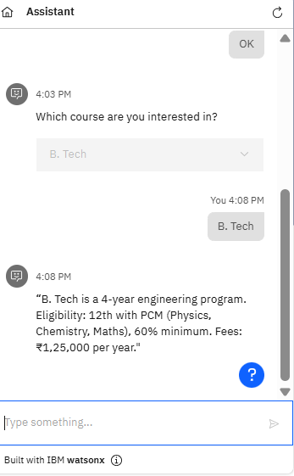
Result

Slide 12
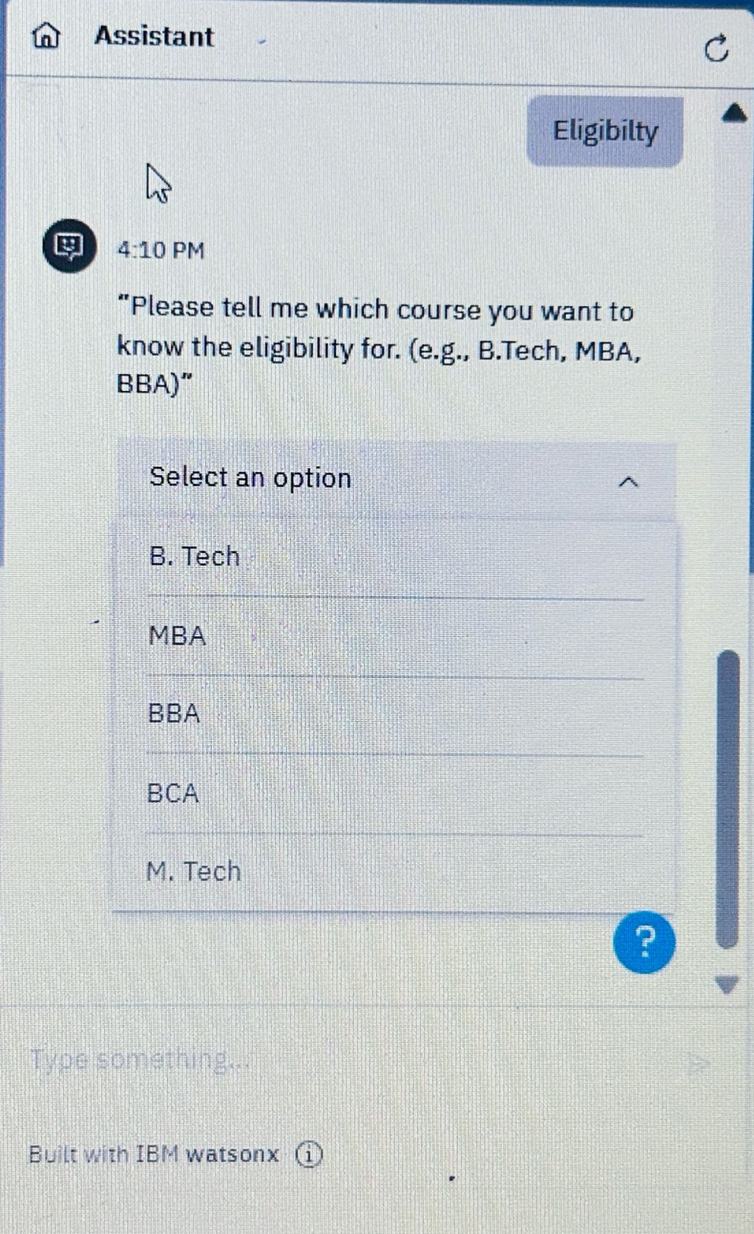
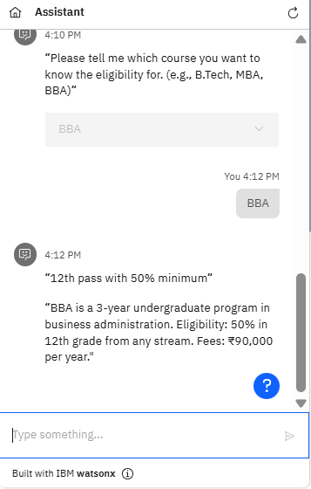
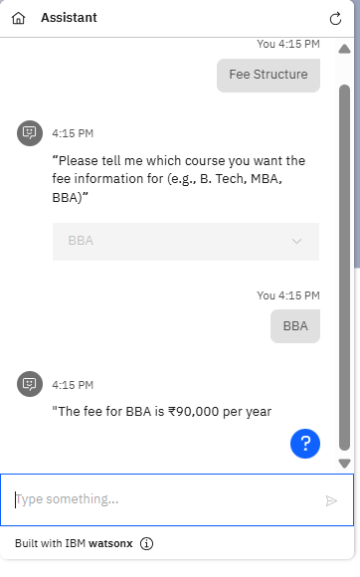
Result

Slide 13
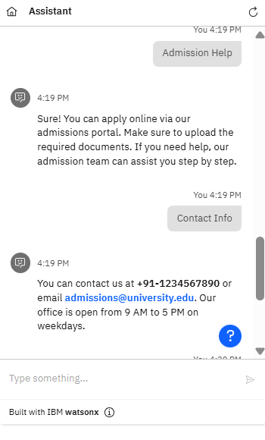
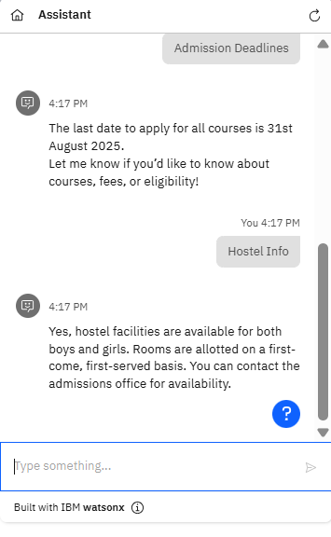
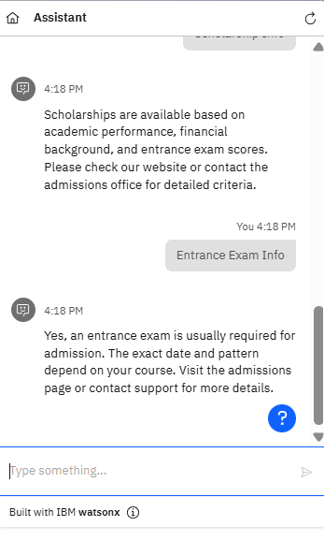
Result

Slide 14
Conclusion
The College Admission Agent streamlines the admission process by providing accurate, instant, and context-aware responses using RAG and IBM Granite. It reduces manual workload, improves applicant experience, and enhances transparency in admissions.

Slide 15
Future scope
Discuss potential enhancements and expansions for the system. This could include incorporating additional data sources, optimizing the algorithm for better performance, and expanding the system to cover multiple cities or regions. Consider the integration of emerging technologies such as edge computing or advanced machine learning

Slide 16
References
IBM Granite & Cloud Lite Documentation
LangChain & HuggingFace (RAG Framework)
Official College Admission Circulars
Research on RAG (Lewis et al., 2020)

Slide 17
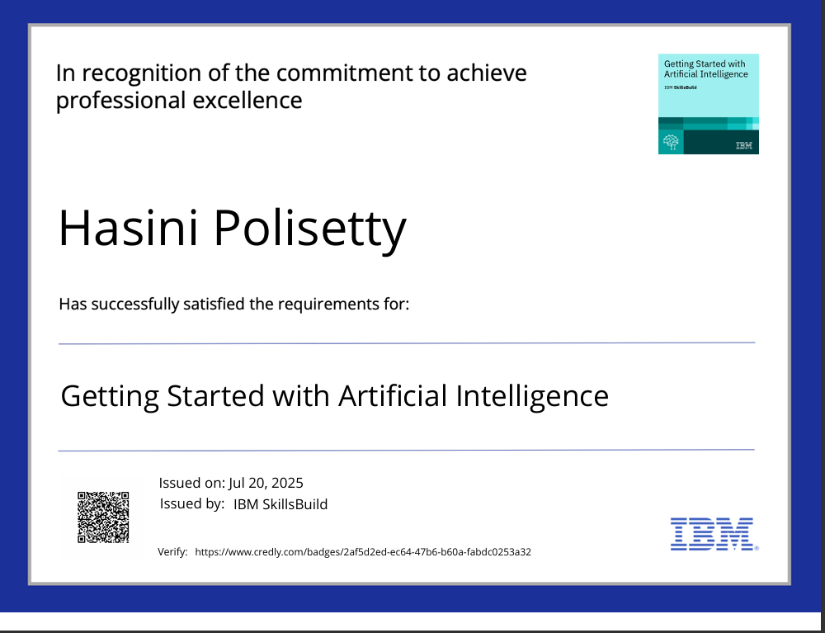
IBM Certifications

Slide 18
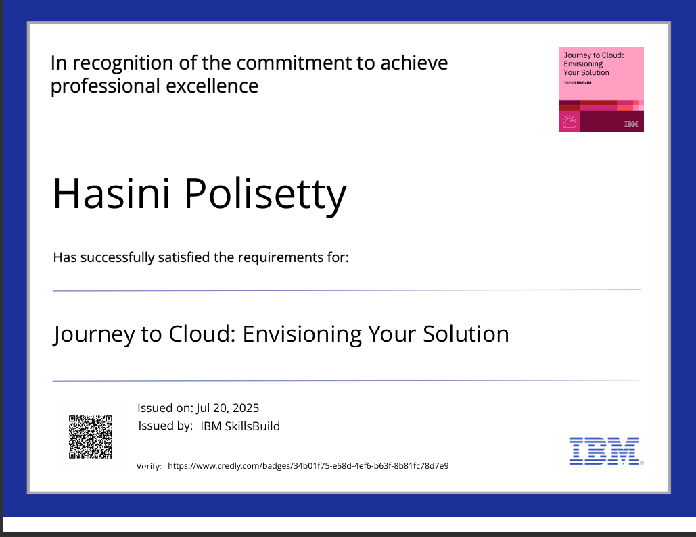
IBM Certifications

Slide 19
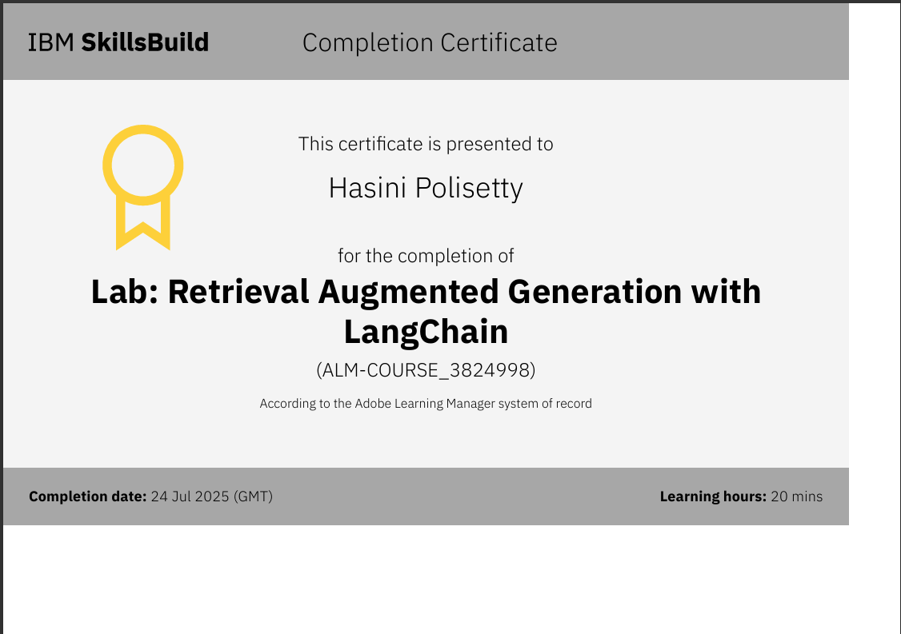
IBM Certifications

Slide 20
THANK YOU

